Slide 1
Retail Sales Analysis using Postgres SQL

Slide 2
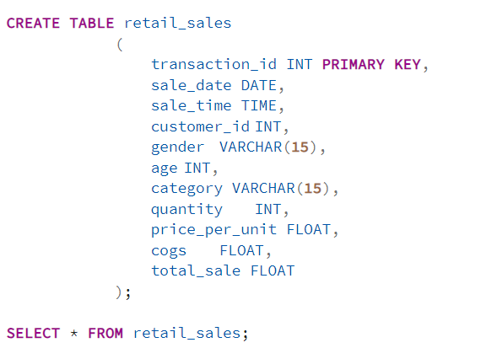
Schemas

Slide 3
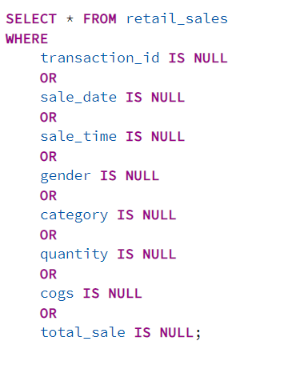
Data Cleaning
Checking for Null Values

Slide 4
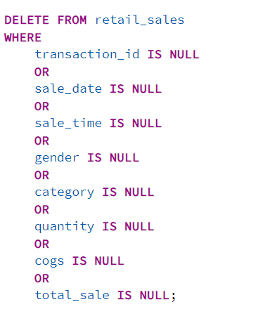
Data Cleaning
Deleting NULL Values

Slide 5




Data Exploration
How many sales we have?
How many unique customers we have ?

Slide 6

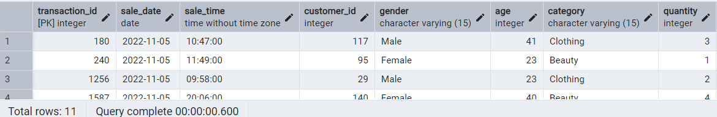
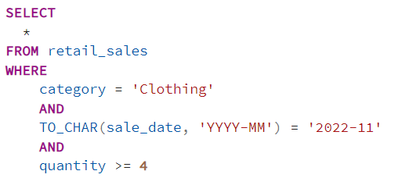
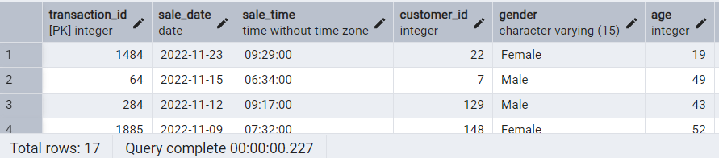
Queries
1 . Write a SQL query to retrieve all columns for sales made on '2022-11-05
2 Write a SQL query to retrieve all transactions where the category is 'Clothing' and the quantity sold is more than 4 in the month of Nov-2022

Slide 7
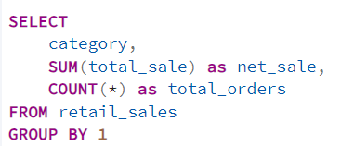
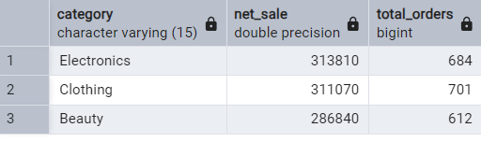
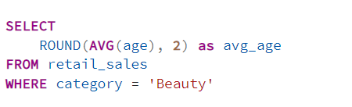

Queries
3 . Write a SQL query to calculate the total sales (total sales) for each category.
4 . Write a SQL query to find the average age of customers who purchased items from the 'Beauty' category.

Slide 8

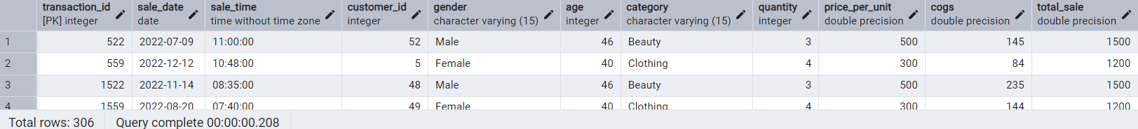
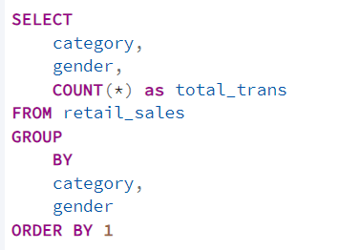
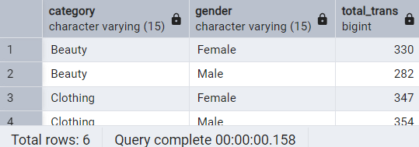
Queries
5 . Write a SQL query to find all transactions where the total sale is greater than 1000.
6 . Write a SQL query to find the total number of transactions (transaction_id) made by each gender in each category.

Slide 9
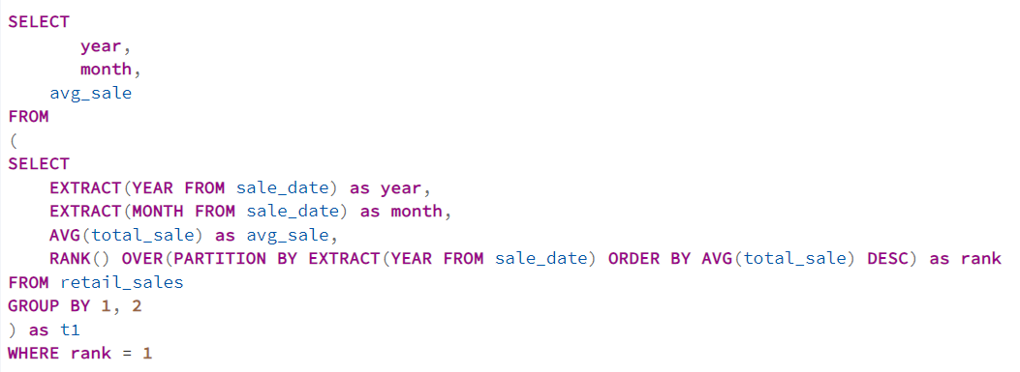
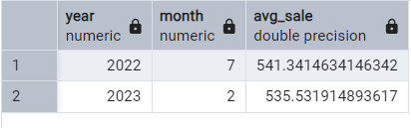
Queries
7 . Write a SQL query to calculate the average sale for each month. Find out best selling month in each year

Slide 10
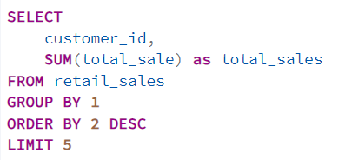
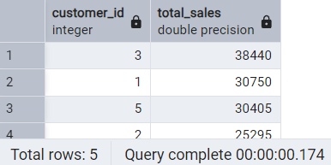
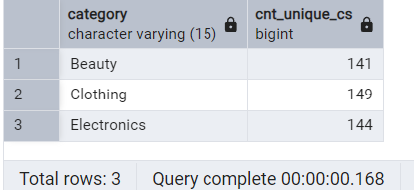
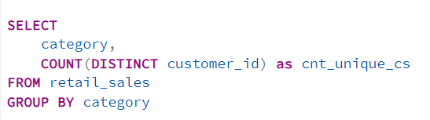
Queries
8 . Write a SQL query to find the top 5 customers based on the highest total sales
9 . Write a SQL query to find the number of unique customers who purchased items from each category.

Slide 11
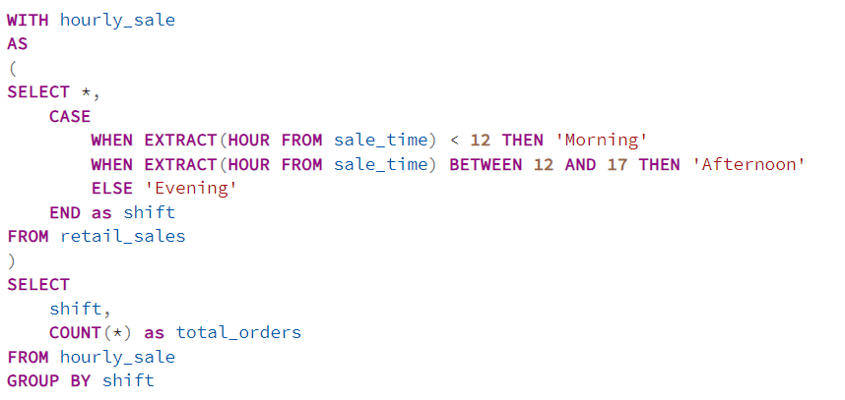
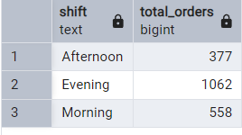
Queries
10 . Write a SQL query to create each shift and number of orders (Example Morning <12, Afternoon Between 12 & 17, Evening >17)

